Slide 1
Estimating population density from passive acoustic surveys: Current methods and new challenges
Ben Stevenson¹, Jing Liu¹, Melissa Bather¹, Sarah McGrath², and Lily Martin³
¹Department of Statistics, University of Auckland ²School of Archaeology and Anthropology, ANU ³Warnell School of Forestry and Natural Resources, University of Georgia

Slide 2
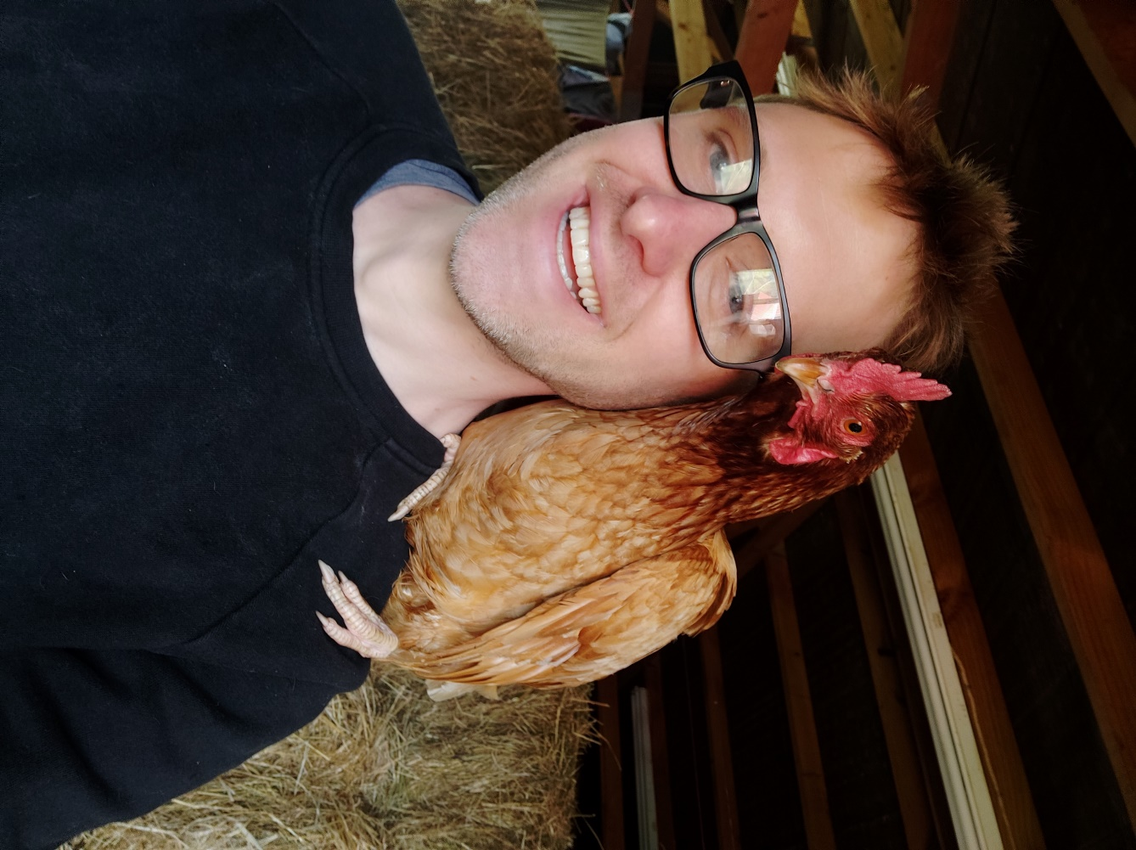
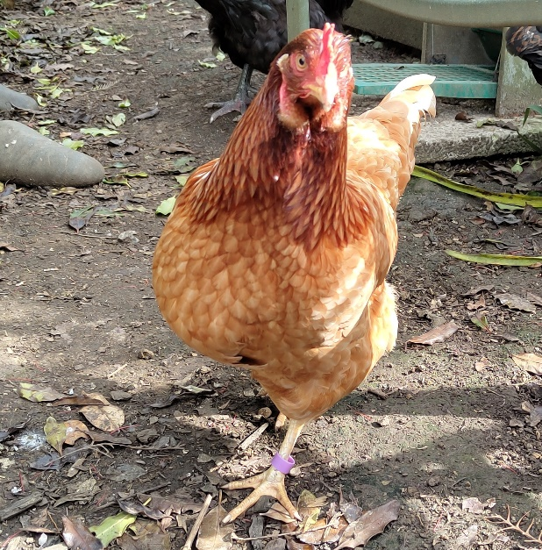
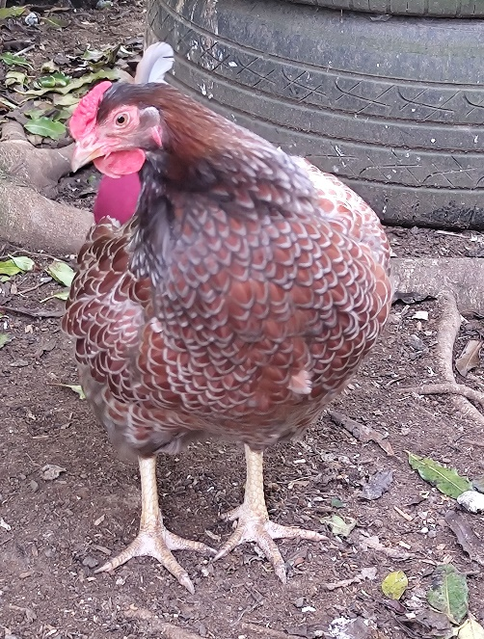
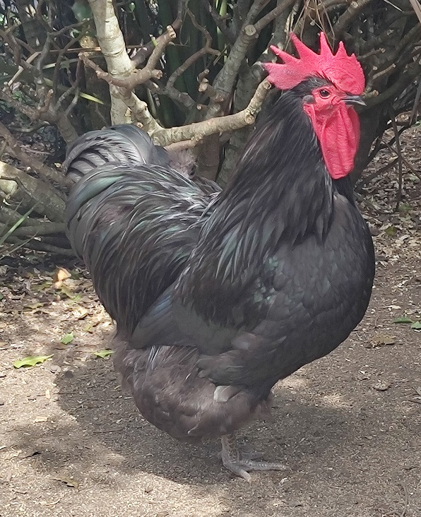
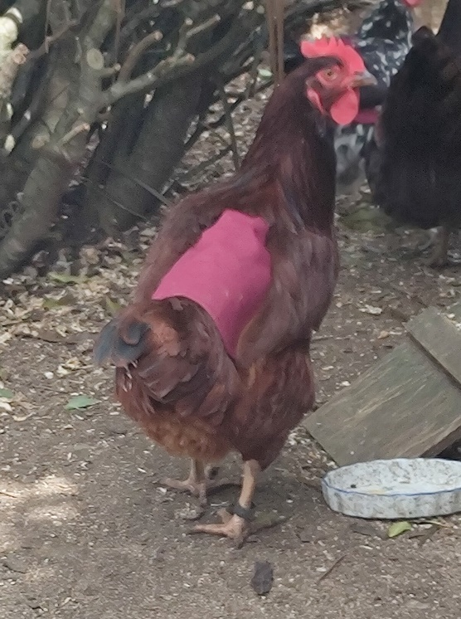
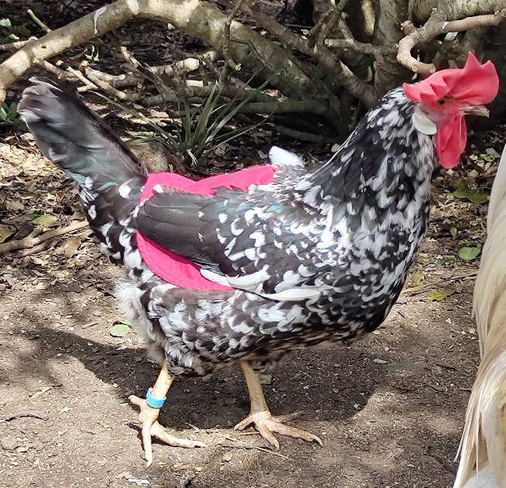
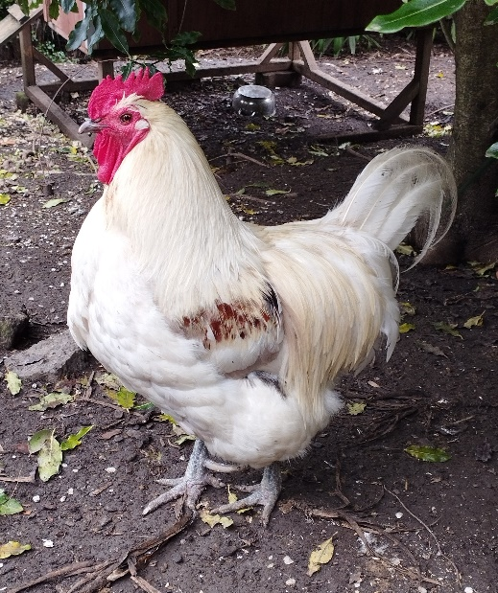
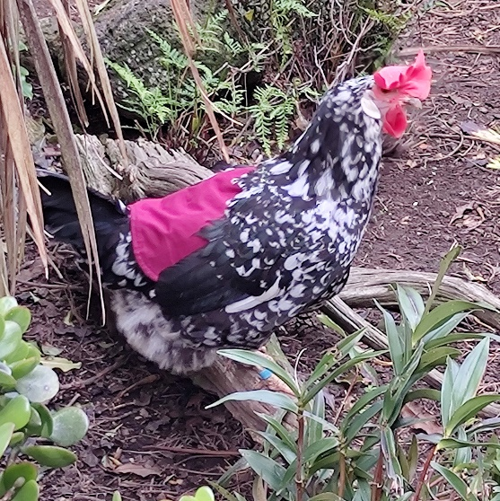
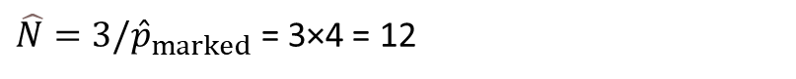
Capture-recapture
$${\hat{p}}_{marked}=1/4$$
$\hat{N}=3/{\hat{p}}_{marked}$ = 3×4 = 12
True N = 13! Hooray!
Occasion 1
Occasion 2
Rita
Angelica
Clarence
Morag
Camilla
Bennett
Camilla

Slide 3
Capture-recapture data: 1s and 0s
 | Occasion 1 | Occasion 2
Rita | 1 | 0
Morag | 1 | 0
Camilla | 1 | 1
Bennett | 0 | 1
Clarence | 0 | 1
Angelica | 0 | 1
Evelyn | 0 | 0
Vicky | 0 | 0
Lucy | 0 | 0
Estella | 0 | 0
Ann | 0 | 0
Barbara | 0 | 0
Brook | 0 | 0
 | Occasion 1 | Occasion 2
Rita | 1 | 0
Morag | 1 | 0
Camilla | 1 | 1
Bennett | 0 | 1
Clarence | 0 | 1
Angelica | 0 | 1
We don’t observe these rows
This is all we get

Slide 4
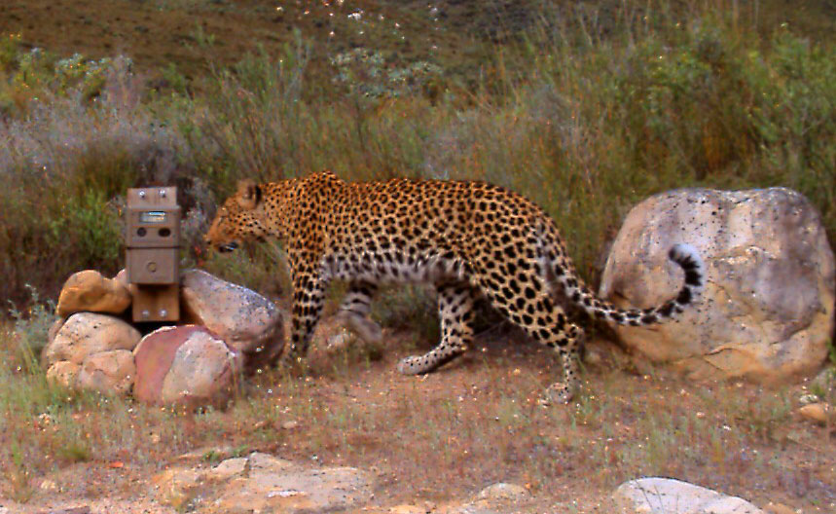
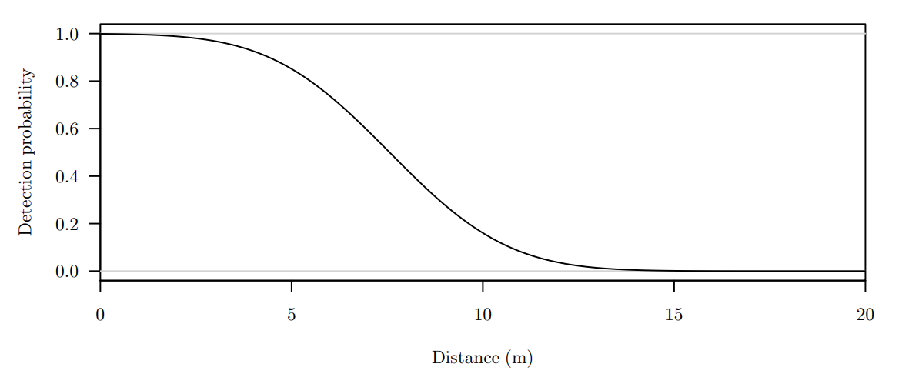
Spatial capture-recapture
Each animal has a location, perhaps it’s home (e.g., burrow or nest)
We want to fit a spatial point process to the locations, which will tell us about population density and distribution
A homogeneous Poisson process just has one parameter: animal density
An inhomogeneous process allows to estimate distribution, although we require spatial covariates
We detect animals using detectors
Detection depends on the distance between the animal location and detector
Not all animals are detected…
… And locations of those that are detected aren’t observed
We are fitting a spatial point process without observing the points!
All we have are 1s and 0s: which detectors detected which animals
The locations are latent variables, so model fitting requires integrating over these locations or sampling them

Slide 5
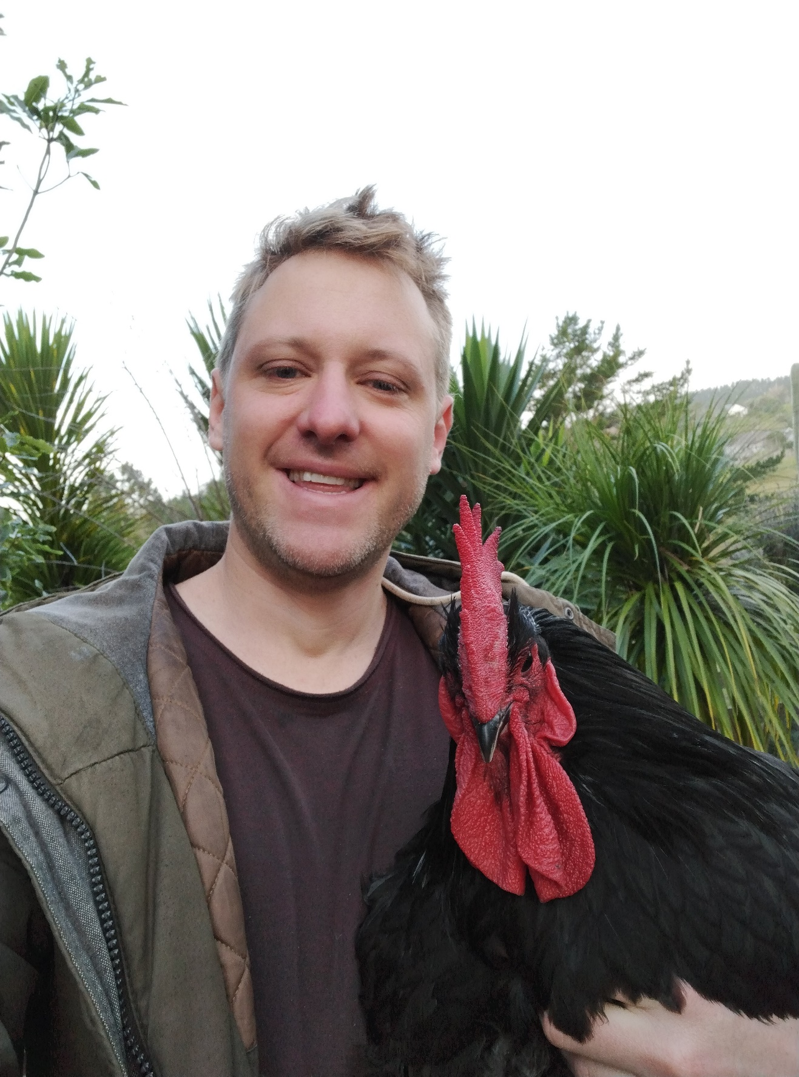
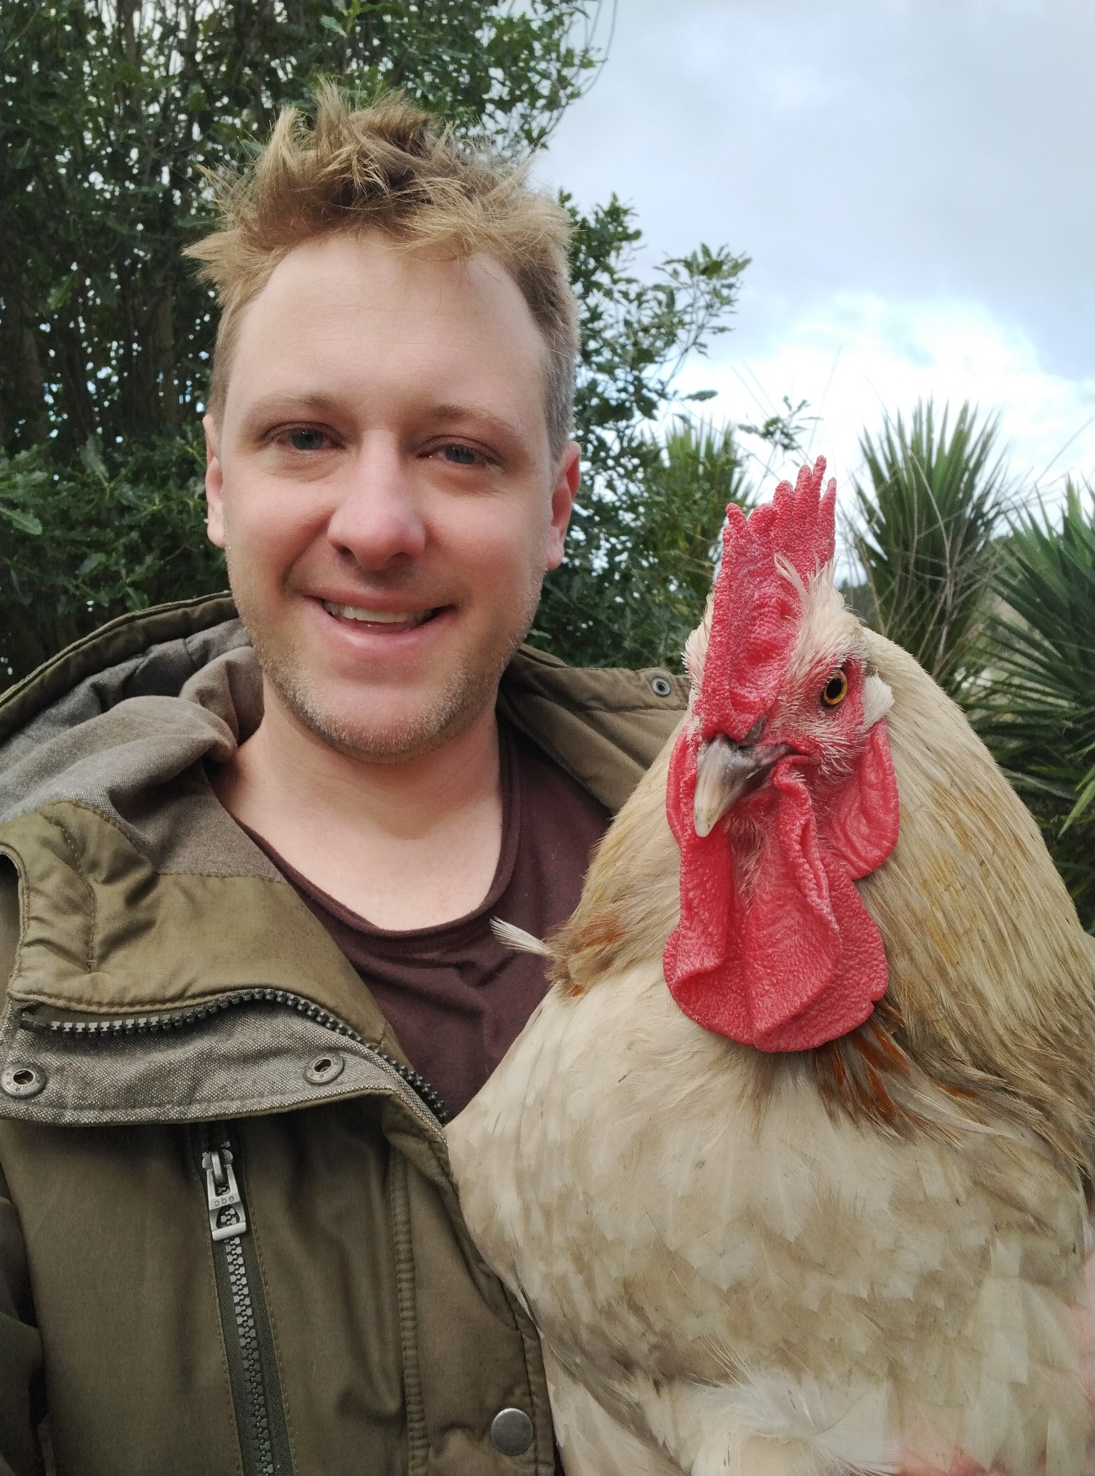

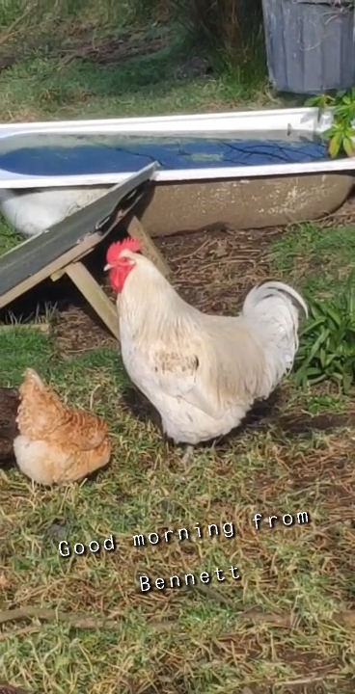

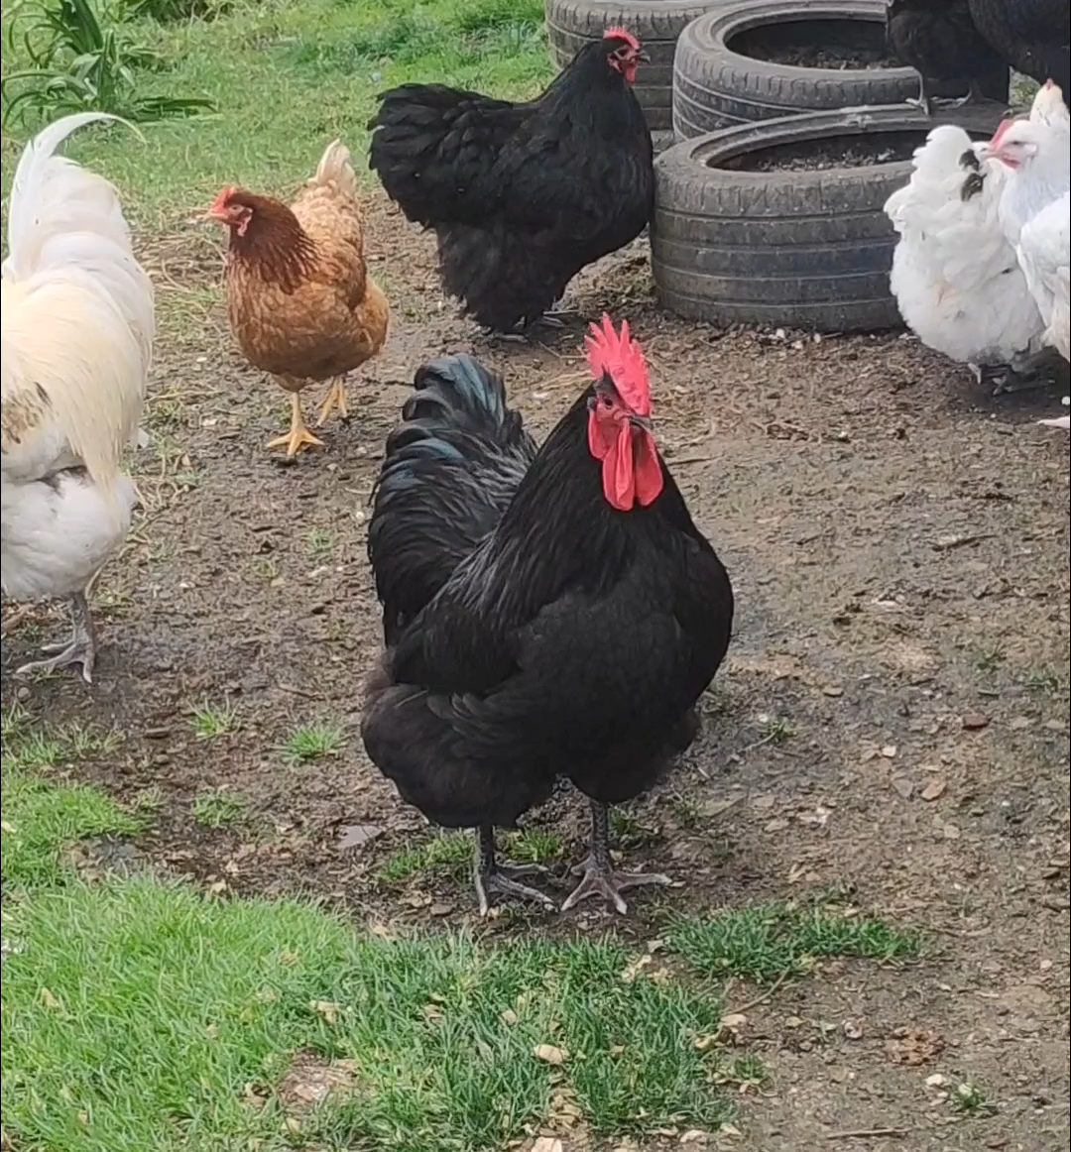
Another type of sensor: acoustic receivers

Slide 6
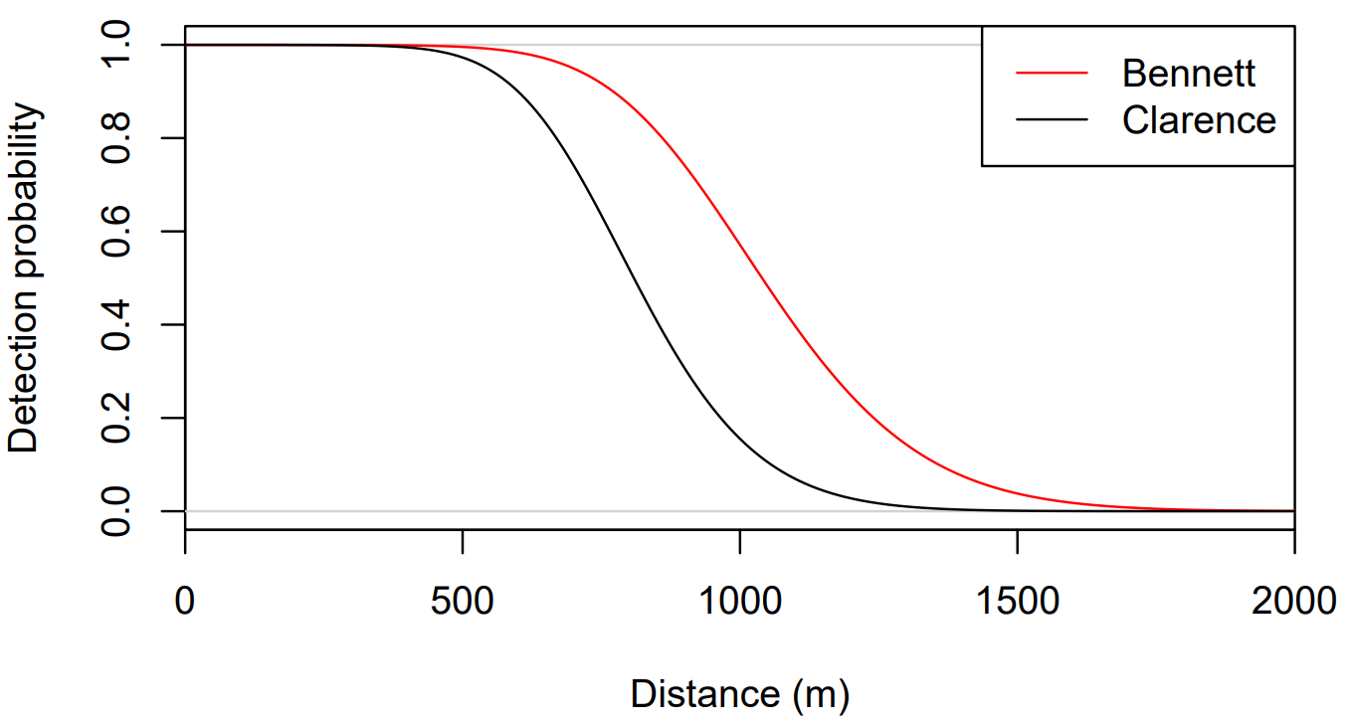
Acoustic spatial capture-recapture
An ASCR model can estimate animal density, call rate, and detection function:
 | Microphone A | Microphone B | Microphone C
Bennett | 1 | 1 | 0
Bennett | 1 | 1 | 0
Bennett | 1 | 1 | 1
Clarence | 0 | 1 | 1
Clarence | 0 | 0 | 1
Clarence | 0 | 0 | 0
Clarence | 0 | 0 | 1
Other 1 | 1 | 0 | 0
Other 1 | 1 | 0 | 0
Other 2 | 0 | 0 | 0
Other 2 | 0 | 0 | 0
Other 2 | 0 | 0 | 0
 | Microphone A | Microphone B | Microphone C
 | 1 | 1 | 0
 | 1 | 1 | 0
 | 1 | 1 | 1
 | 0 | 1 | 1
 | 0 | 0 | 1
 | 0 | 0 | 1
 | 1 | 0 | 0
 | 1 | 0 | 0
 | Microphone A | Microphone B | Microphone C
Bennett | 1 | 1 | 0
Clarence | 0 | 1 | 1
 | Microphone A | Microphone B | Microphone C
Bennett | 1 | 1 | 0
Clarence | 0 | 1 | 1
Other 1 | 1 | 0 | 0
Other 2 | 0 | 0 | 0
 | Microphone A | Microphone B | Microphone C
Bennett | 1 | 1 | 0
Bennett | 1 | 1 | 0
Bennett | 1 | 1 | 1
Clarence | 0 | 1 | 1
Clarence | 0 | 0 | 1
Clarence | 0 | 0 | 1
Other 1 | 1 | 0 | 0
Other 1 | 1 | 0 | 0
If we can’t recognise individuals from their calls, we can still estimate call density, and convert this to animal density if we can obtain a separately estimated call rate
We can achieve all of this without knowing where the animals are
Stevenson et al. (2021) A spatial capture-recapture model to estimate call rate and population density from passive acoustic surveys. Methods in Ecology and Evolution, 12, 432—442.
Stevenson et al. (2015) A general framework for animal density estimation from acoustic detections across a fixed microphone array. Methods in Ecology and Evolution, 6, 38—48.
Borchers et al. (2015) A unifying model for capture-recapture and distance sampling surveys of wildlife populations. Journal of the American Statistical Association, 110, 195—204.

Slide 7
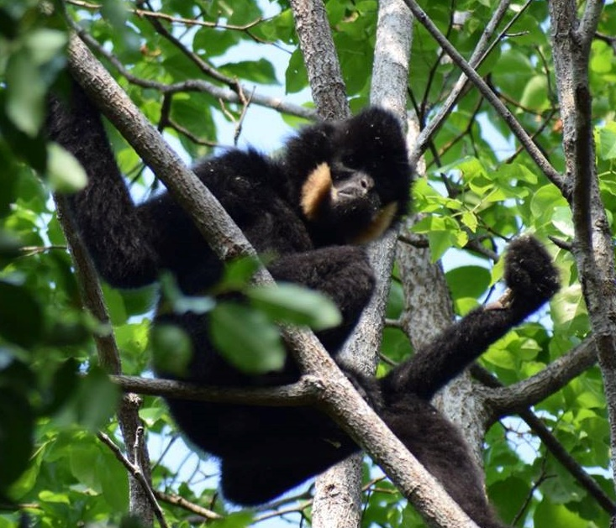
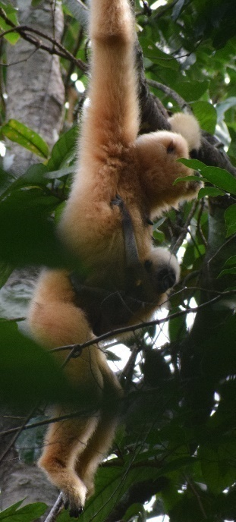
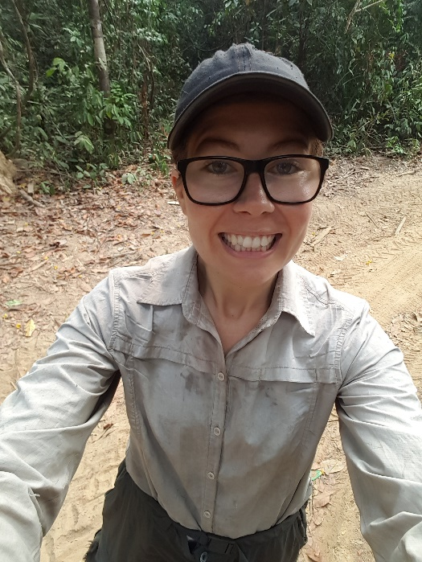
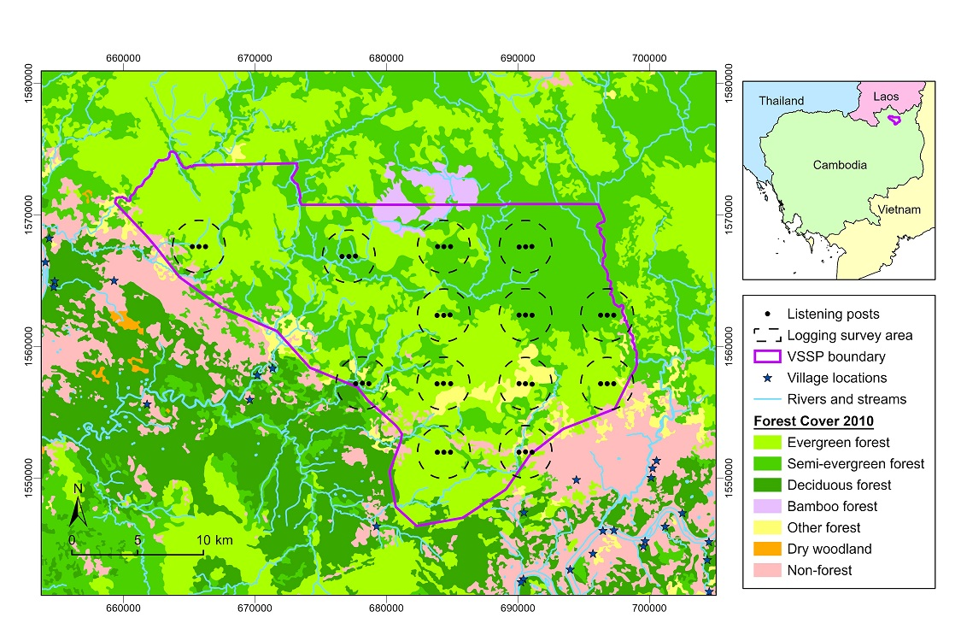
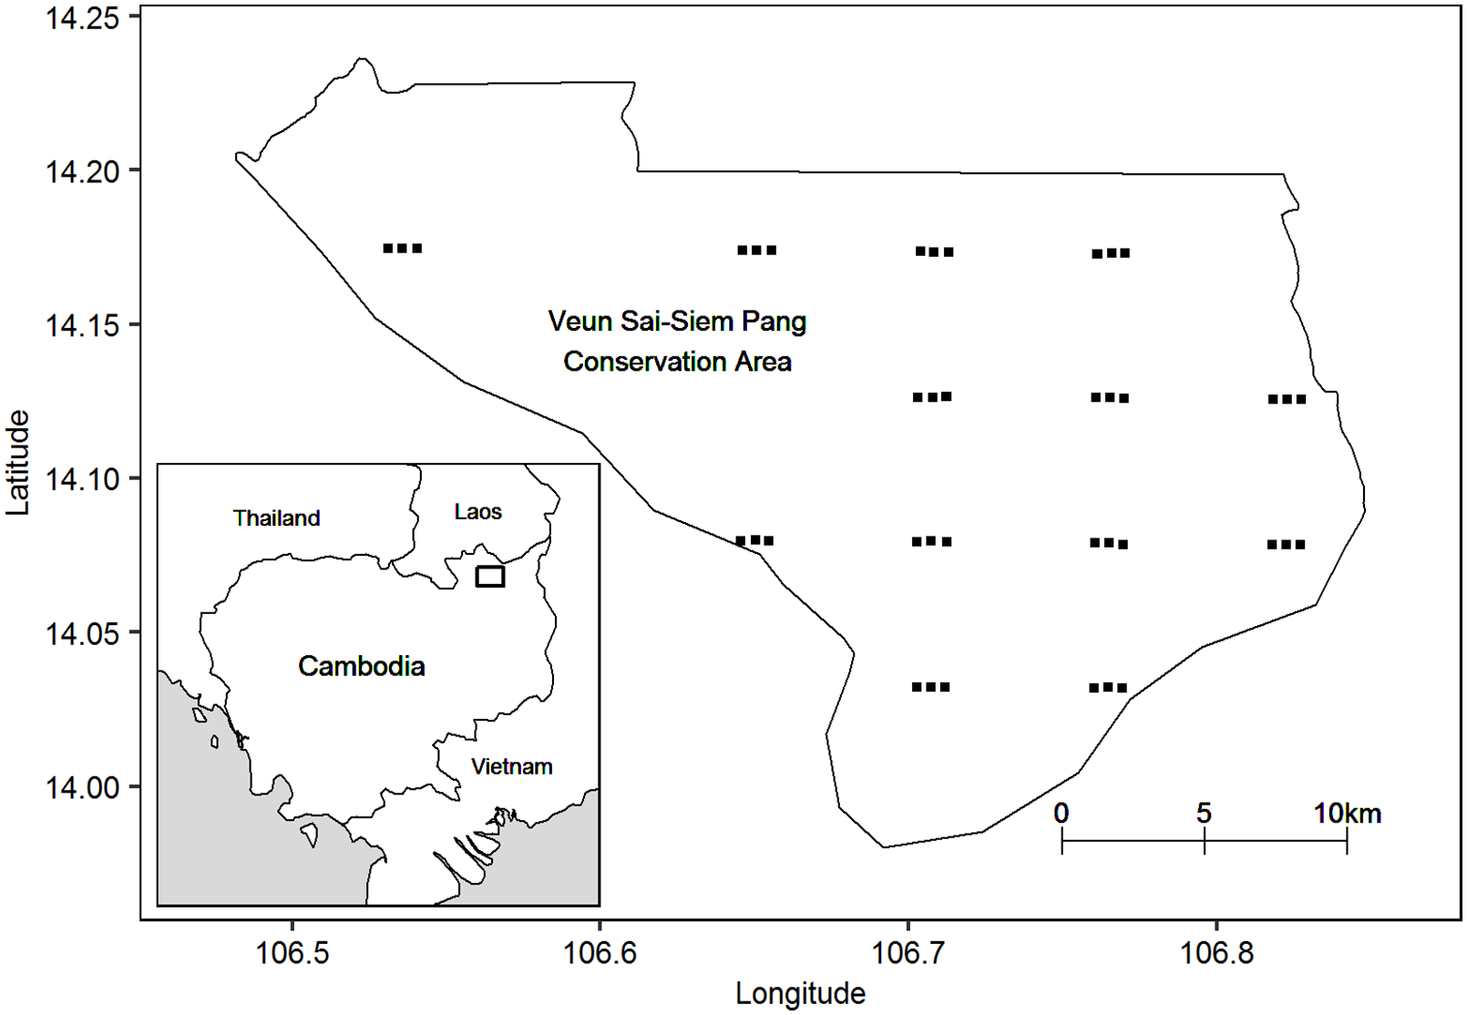
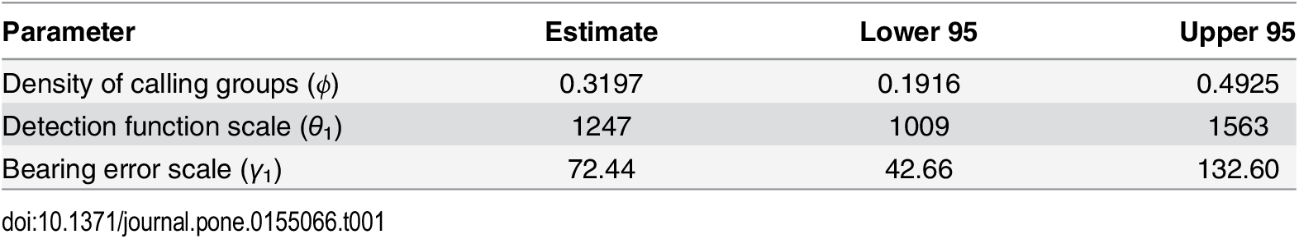
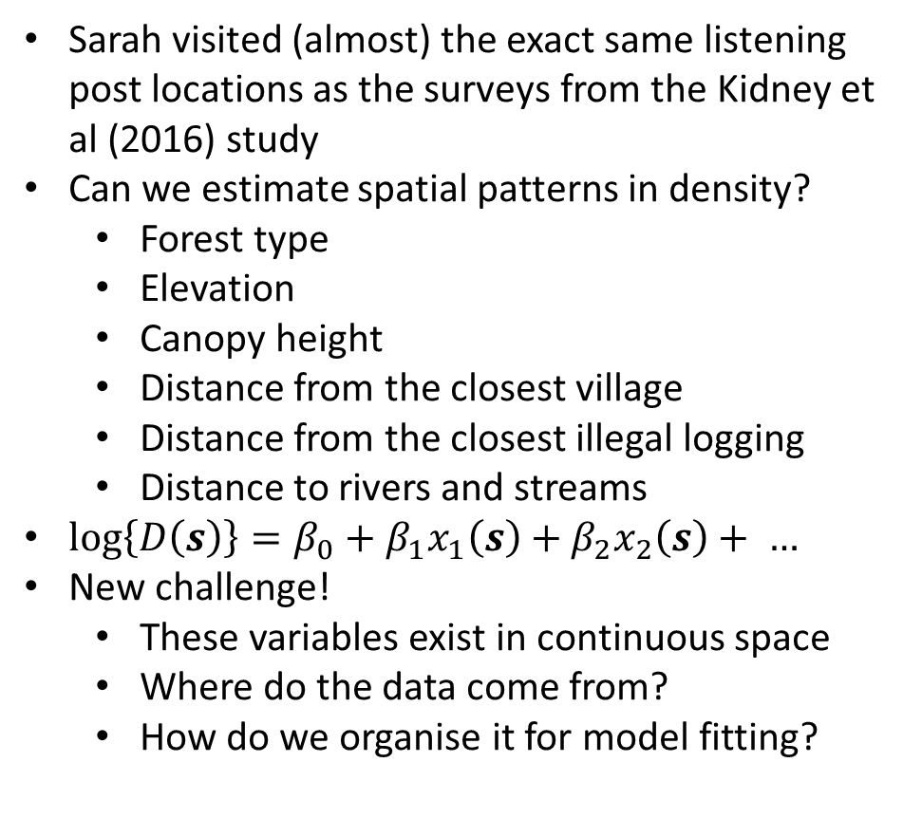
Sarah’s Gibbons
Fast forward to a new decade!!!
Rewind to 2012…
Sarah visited (almost) the exact same listening post locations as the surveys from the Kidney et al (2016) study
Can we estimate spatial patterns in density?
Forest type
Elevation
Canopy height
Distance from the closest village
Distance from the closest illegal logging
Distance to rivers and streams
$log\left\{D\left(s\right)\right\}=β_{0}+β_{1}x_{1}\left(s\right)+β_{2}x_{2}\left(s\right)+ …$
New challenge!
These variables exist in continuous space
Where do the data come from?
How do we organise it for model fitting?
Kidney et al. (2016) An efficient acoustic density estimation method with human detectors applied to gibbons in Cambodia. PLoS ONE, 11, e0155066.

Slide 8

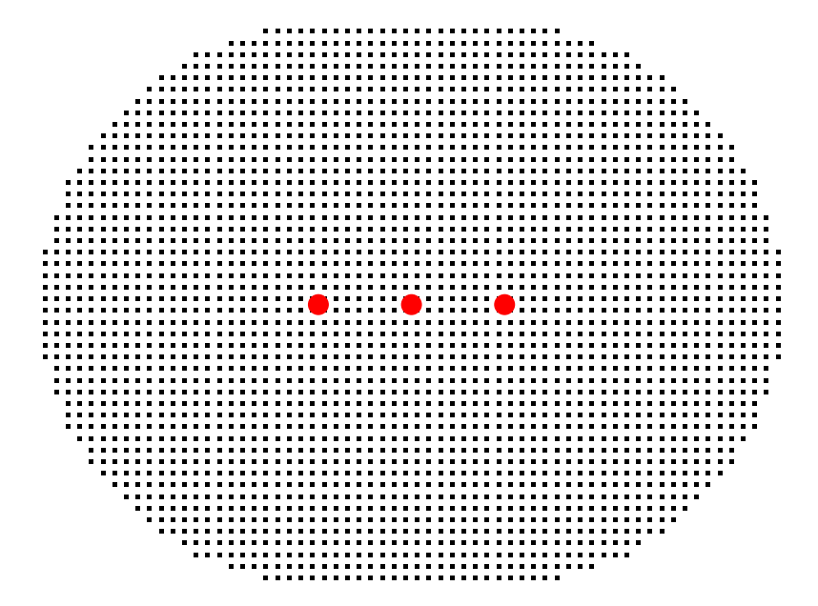
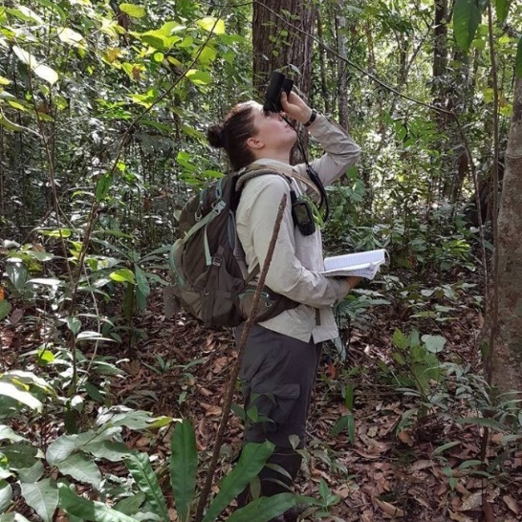

Challenge 1: Spatial data
We handle unknown calling locations by integrating over space
We can approximate these integrals by summing over a discrete grid of points, known as the habitat mask
For models with spatial variation in density, we require a value for each covariate at every mask point
Spatial variables are all measured at different resolutions, and locations they’re observed at will not align with the mask
We can do spatial interpolation
Then we just pretend the interpolated data are correct

Slide 9
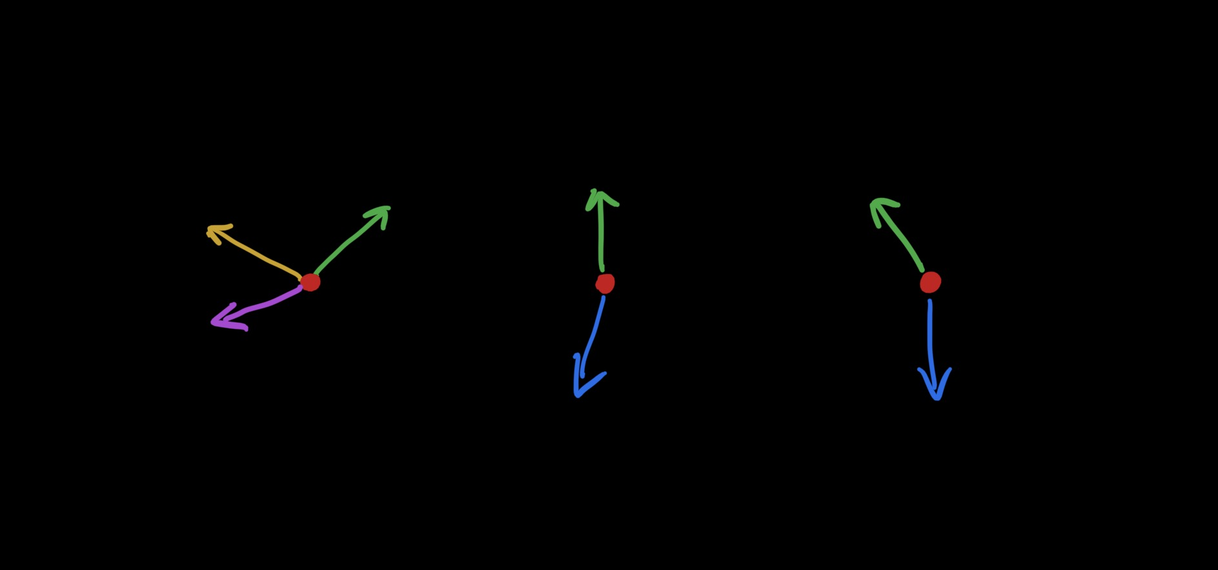
Challenge 2: Figuring out detection records
Listening post 1: “I heard a great call of a female at 0602 hrs coming from a bearing of 060. It sounded quite faint so it might have been some distance away from me. It had a strange little trill at the end, and I think I heard the beginning of a male response, but it was difficult to hear”
Listening post 2: “Both a female and male duetted quite close by at 0601 hrs quite close by at a bearing of 310.”
Same call?
Same group?
Listening post 3: “There was a great call at 0617 from a bearing of 102, which was quite distinctive because it had a trill at the end.”

Slide 10

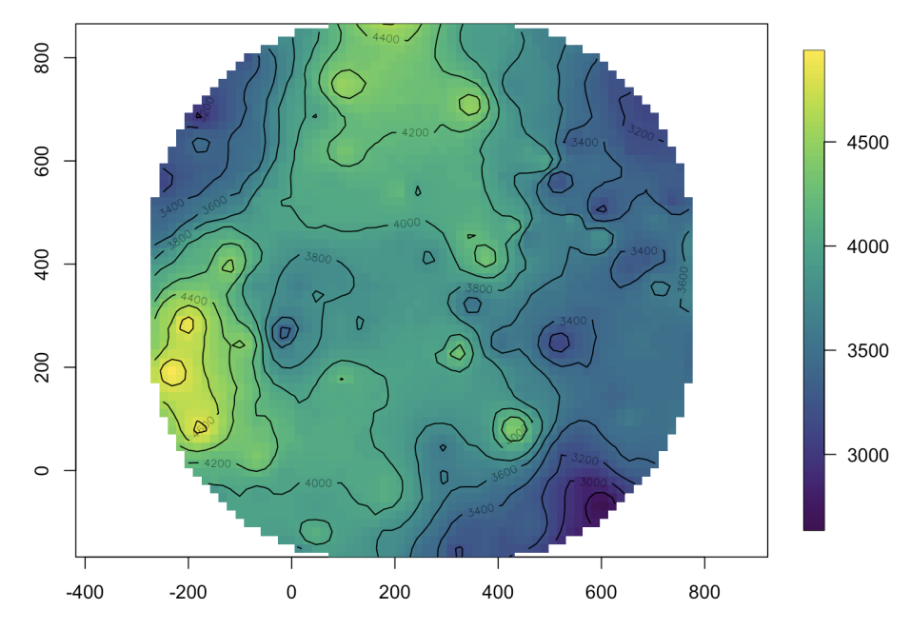
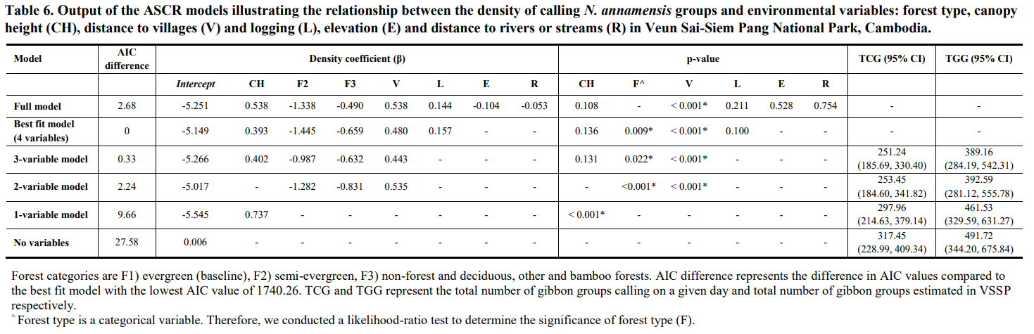
It’s all worth it in the end!
Analysis by Jing!
There’s an estimated density surface map but I’m not allowed to show it to you
Simulated example
McGrath et al. (in press). Density and population size estimates of the endangered northern yellow-cheeked gibbon Nomascus annamensis in selectively logged Veun Sai-Siem Pang National Park in Cambodia using acoustic spatial capture-recapture methods. PLoS ONE.

Slide 11
Lessons from the gibbons…
The data in their raw, purest form are notes taken in the field, satellite imagery, canopy height measured on-the-ground … NOT 1s and 0s!
A big effort to convert these notes to 0s and 1s, and to align spatial covariates—and often this is not reproducible
Synthesising data from different sources can be challenging, time-consuming, and off-putting for ecologists
People won’t use our fancy methods if they’re difficult to implement
We can get so much more from our studies if we go the extra mile
Kidney et al (2016) estimated calling group density
Here we additionally estimated effects of environmental variables on density, and constructed estimated density surfaces
Detection data collected by people rather than devices impedes automated solutions

Slide 12
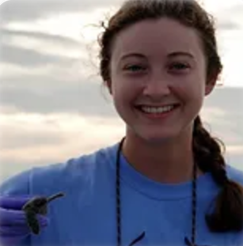
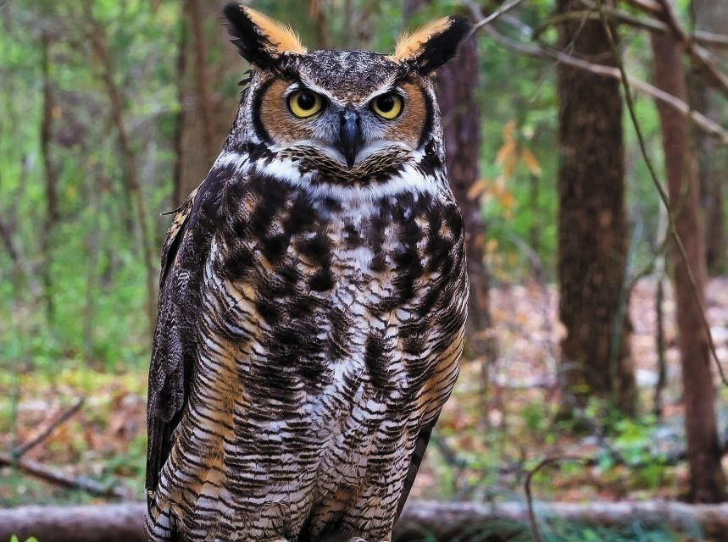
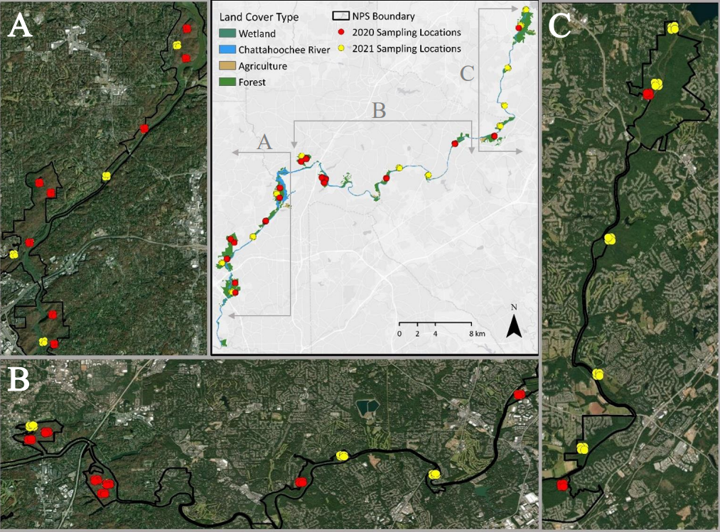
Lily’s Owls
100 m
Multiple arrays of ARUs deployed in Chattahoochee River National Recreational Area, Georgia, USA, to monitor Great Horned Owls
In total, an overwhelming tens of thousands of hours of recordings!
Nine hours per night per recorder, every second day, for two months in 2020 and for four months in 2021, at 17 sites

Slide 13
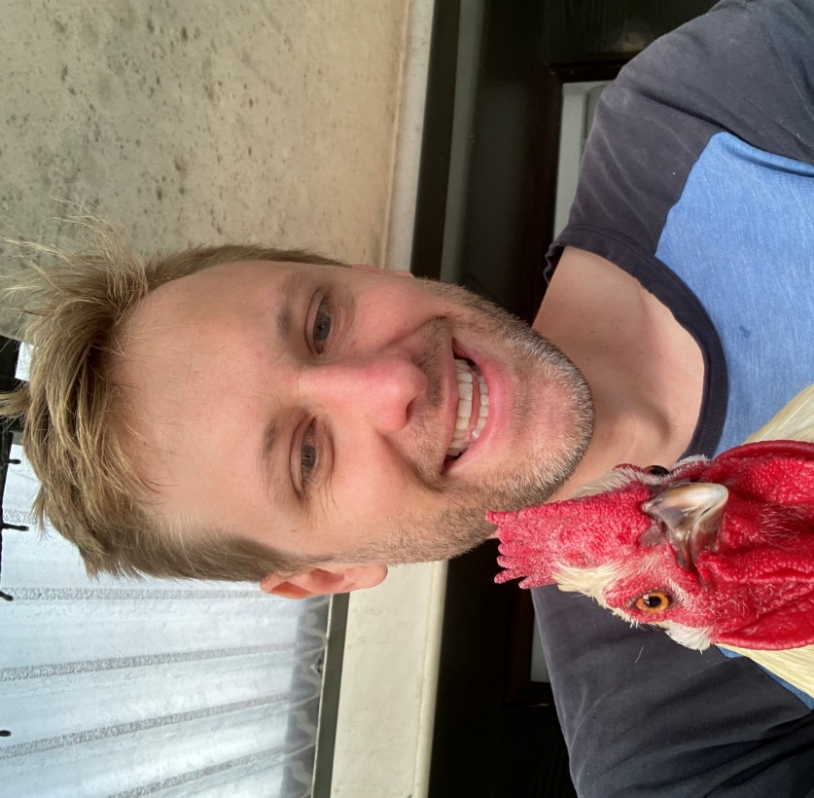
Hello! I read your paper and I want to use your method but I’m a bit stumped. I have recordings in .wav files. Could you give me a hand?
Sure! You need to convert the data from a .wav file into 0s and 1s because that’s how capture-recapture software usually works
Great! How do I do that?
idk lol

Slide 14

Some months later…
Raven Pro 1.6 measures similarities between detected calls using spectrogram cross-correlation
ARUs produce .wav files
Use hierarchical clustering analysis in R to assign identities to calls
Determine sex of caller using number of hoots, frequency range, etc
Kaleidoscope Pro 5 identifies owl calls
Do some data wrangling in R to read data into acre
Manual checking of every single detection
Match detections to calls using times of arrival

Slide 15
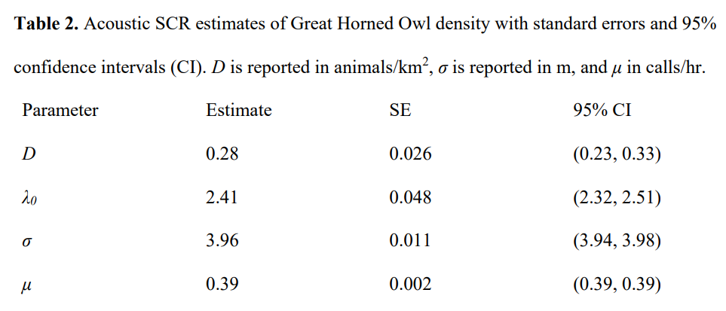
… And some more months later…
Martin et al. (in press). Estimating owl population density using acoustic spatial capture-recapture. Journal of Raptor Research.

Slide 16
Lessons from the owls
The data in their raw, purest form are audio recordings, which helps with reproducibility
Transforming audio recordings to detection records in 0s and 1s might involve a long, convoluted, and complicated workflow, which doesn’t help with reproducibility
With tens of thousands of hours of recordings, we can get precise estimates of animal density
Sarah (PhD student) and Lily (MSc student) are seriously impressive!
The new generation of ecologists needs to be equipped with all sorts of practical, statistical, and computational skills

Slide 17
Challenges for statisticians
We aren’t really fitting models to data, we’re fitting models to outputs from other models/algorithms and assuming no error
Manual detection matching and spatial interpolation of covariates for gibbons
Automated detection matching and individual identification for owls

Slide 18

Raven Pro 1.6 measures similarities between detected calls using spectrogram cross-correlation
ARUs produce .wav files
Use hierarchical clustering analysis in R to assign identities to calls
Determine sex of caller using number of hoots, frequency range, etc
Kaleidoscope Pro 5 identifies owl calls
Statisticians concern themselves with this
Do some data wrangling in R to read data into acre
Manual checking of every single detection
Match detections to calls using times of arrival
Fit models and estimate animal density

Slide 19
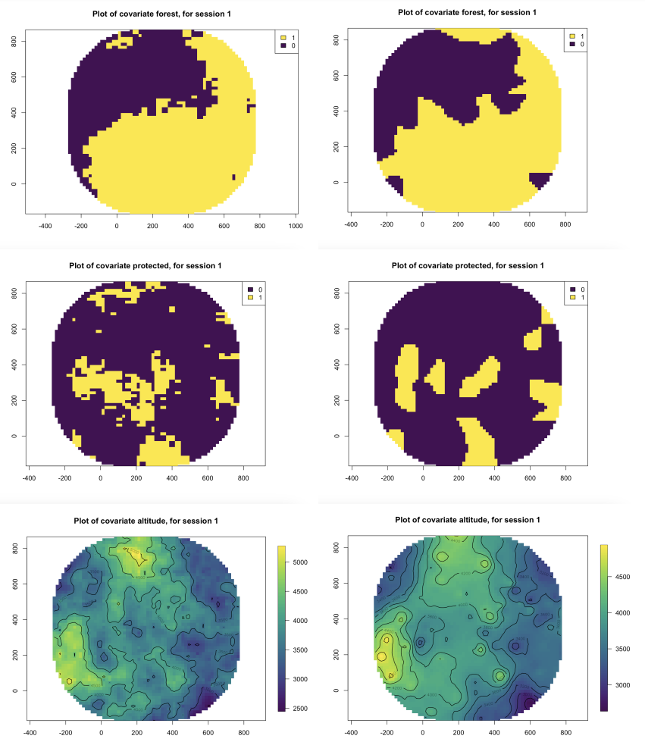
Challenges for statisticians
We aren’t really fitting models to data, we’re fitting models to outputs from other models/algorithms and assuming no error
Manual detection matching and spatial interpolation of covariates for gibbons
Automated detection matching and individual identification for owls
So we need statistical methods that can handle and propagate error
van Dam-Bates et al. (in press) A flexible framework for spatial capture-recapture with unknown identities. Biometrics.
Xu Ning’s talk yesterday was about errors in spatial covariates!
User-friendly software packages that play nicely together
Acoustic SCR software now handles spatial interpolation automatically
Training materials for newcomers
https://www.scr-acoustic.com/
True covariates
Interpolated covariates

Slide 20

We need to make it easier!
How we often do things:
Formulate hypotheses
Collect data
Wrangle data
Analyse data
Draw conclusions
ACTION!
Each arrow often represents months or years of work!
How we could do things with autonomous, continuously running sensors:
Automated data collection
Formulate hypotheses
(Semi) Automated wrangling
Act in real-time!
Draw conclusions
(Semi) Automated analysis
ACTION!

Slide 21

Thanks for listening!

Slide 22
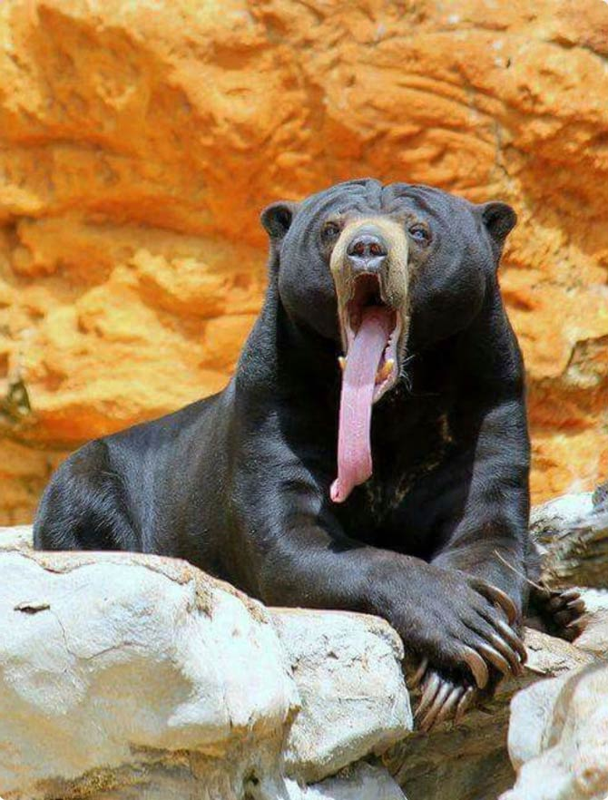
Respect the data
“Collecting the data for this particular article was probably the most challenging thing I have done in my entire life. From the number of staff and amount of money it required, the insane hours, the physical exhaustion, and all the setbacks: bears, broken equipment, language barriers, staff getting sick, not reaching sites because lack of tracks, trying to find water, the list goes on and on. This article makes it all worth it though, I really like the approach we have taken in not just reporting results but how/why to do it that way, both with the ASCR and with amount of detail included about how to identify groups, timing of surveys, and so on.”
“Collecting the data for this particular article was probably the most challenging thing I have done in my entire life. From the number of staff and amount of money it required, the insane hours, the physical exhaustion, and all the setbacks: bears, broken equipment, language barriers, staff getting sick, not reaching sites because lack of tracks, trying to find water, the list goes on and on. This article makes it all worth it though, I really like the approach we have taken in not just reporting results but how/why to do it that way, both with the ASCR and with amount of detail included about how to identify groups, timing of surveys, and so on.”
Sarah didn’t quite visit all the same listening posts as the previous study, because a sun bear was taking a nap at one of the sites!

